Slide 1

Final project
Team: Dress for Less

Slide 2
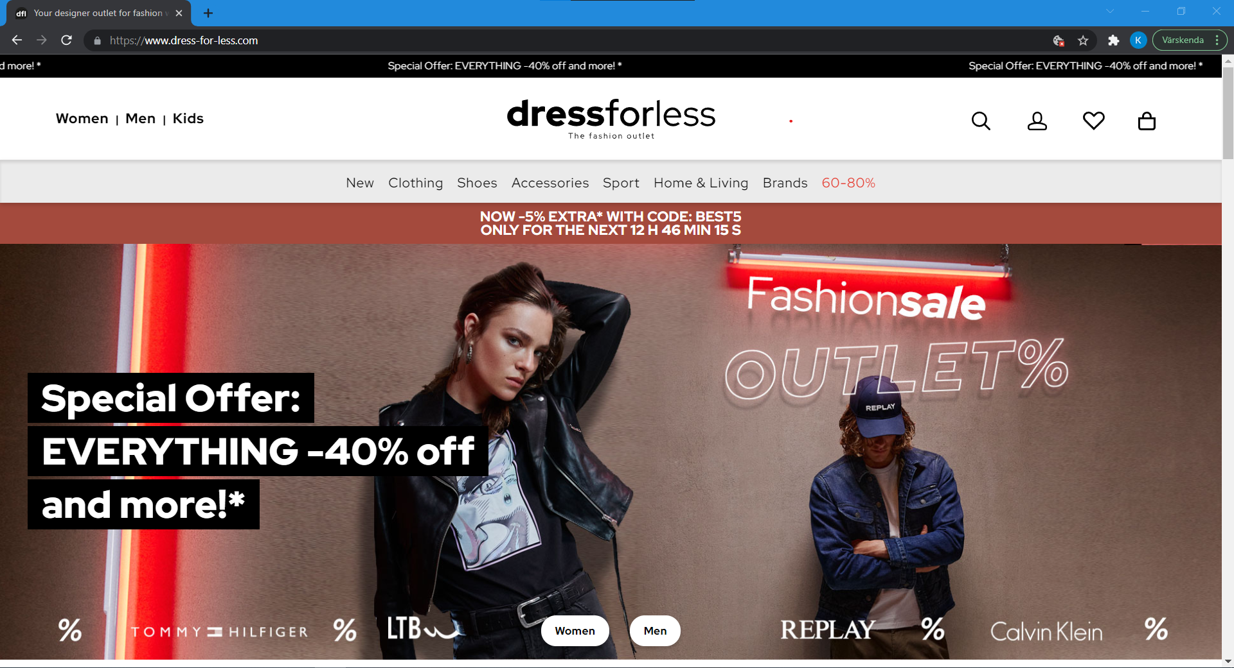
https://www.dress-for-less.com/

Slide 3
Contents
Application analysis
Test plan
Functional testing in TestRail
Bug report in Jira
Other types of Testing
Found issues and List of Recommendations
SWOT analysis

Slide 4

Application analysis

Slide 5
What type of application you have?
We have a responsive web application. It can be viewed on mobile devices too.
What is the purpose of the application?
We have an e-commerce web site to sell outlet fashion for men, women and kids.

Slide 6
What are the main sections/groups of functionalities that you can identify?
Main sections/ groups are as follows:
Login -Register For whom -Men -Women -Kids Categories -Clothing -Shoes -Accessories -Sport | Product list -Filter Product details Payment/ Checkout -Shipping details -Invoice details Wishlist Cart

Slide 7

Identify all types of testing that you will be able to perform for this application:
Functional Testing
Accessibility Testing
Usability Testing
Exploratory Testing

Slide 8
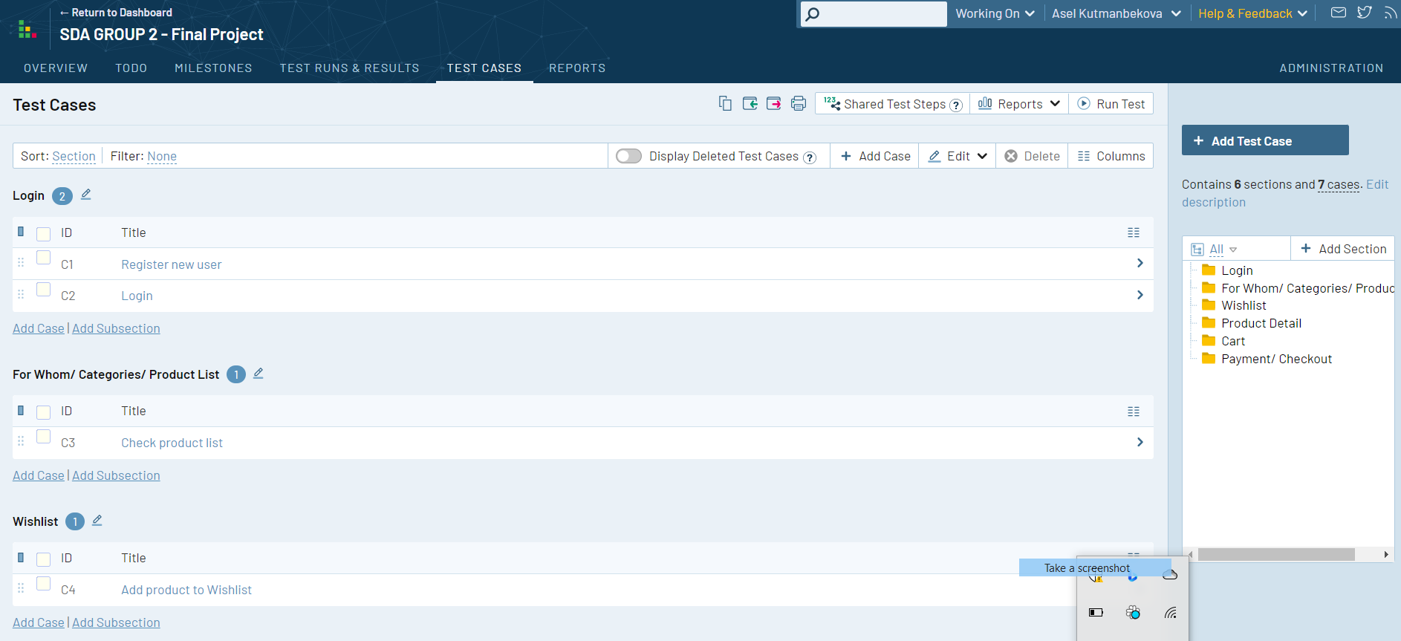
Create a list of test cases for whole application

Slide 9

2. Test plan

Slide 10
Application analysis
Defining scope of workbench
Creating test cases and executing them
Making bug reports
Defining other types of testing
Making list of recommendation for improvements
Making SWOT analysis

Slide 11

3. Functional Testing in TestRail

Slide 12
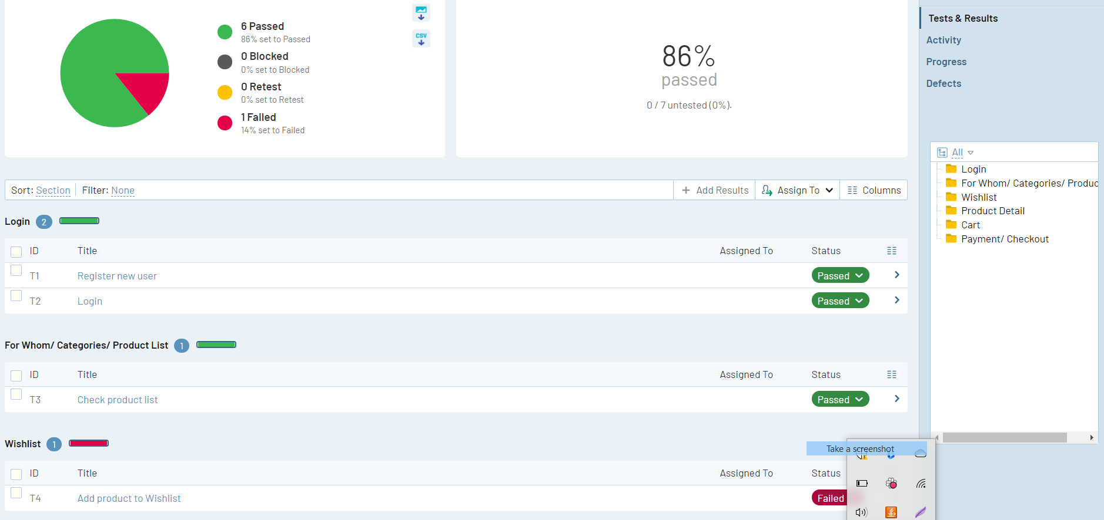
Executing Functional Tests in TestRail

Slide 13


4. Bug report in Jira

Slide 14
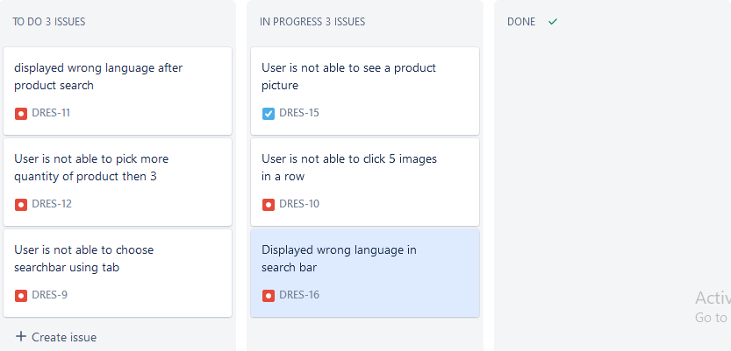
List of bugs reported in project management tool - Jira

Slide 15
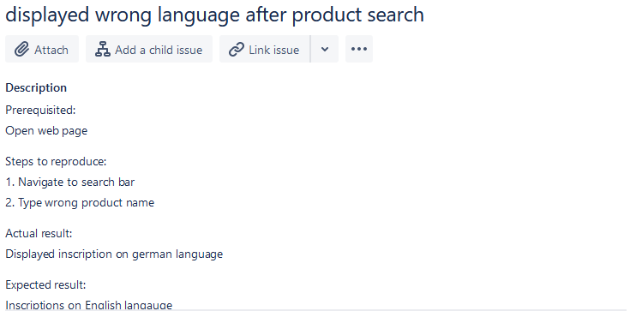

Slide 16
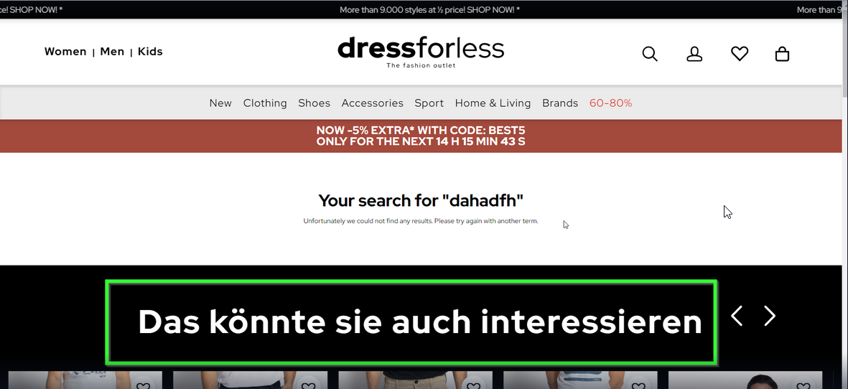

Slide 17
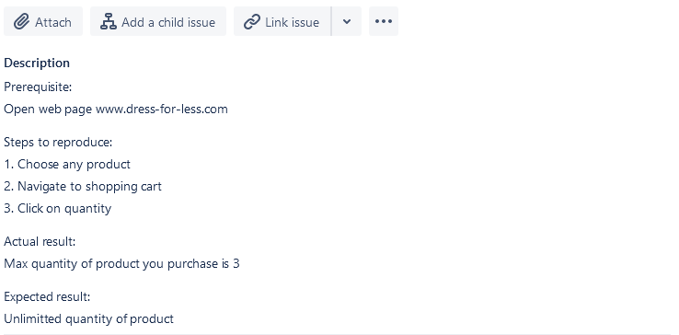
User is not able to pick more quantity of product then 3

Slide 18
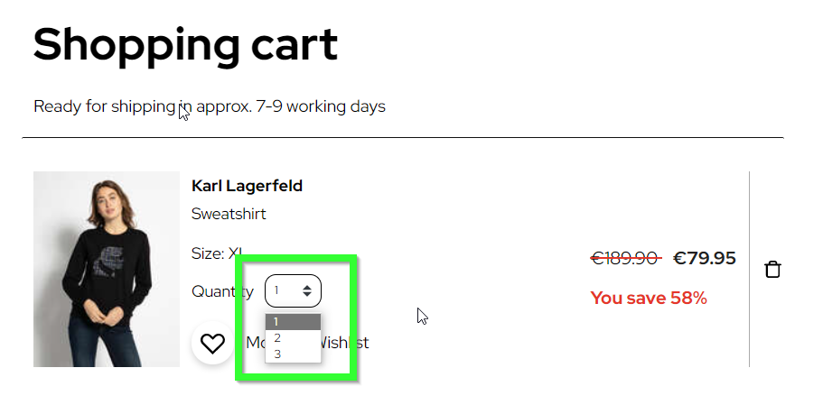

Slide 19
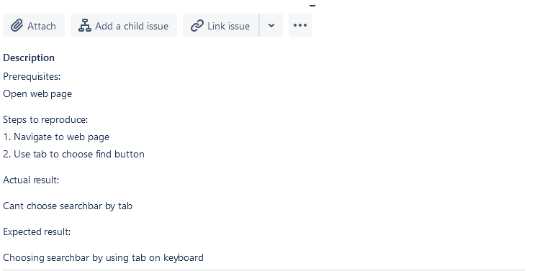
User is not able to choose search bar using tab

Slide 20
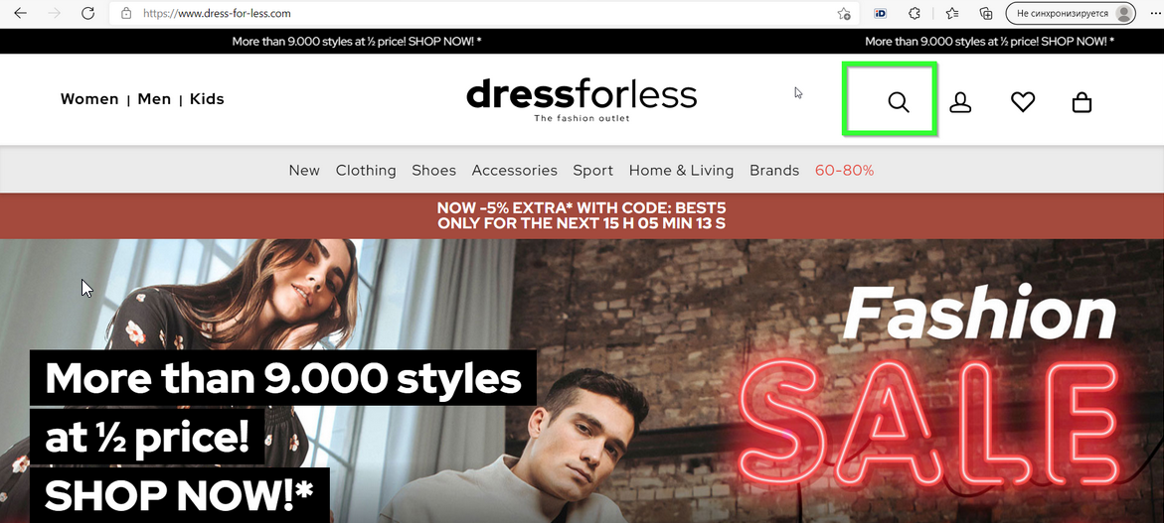

Slide 21
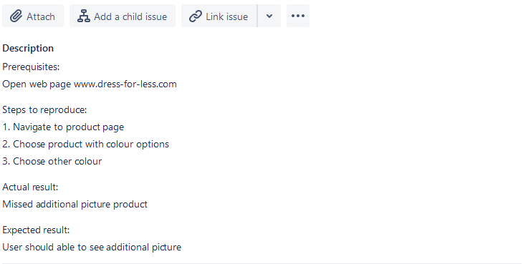
User is not able to see a product picture

Slide 22
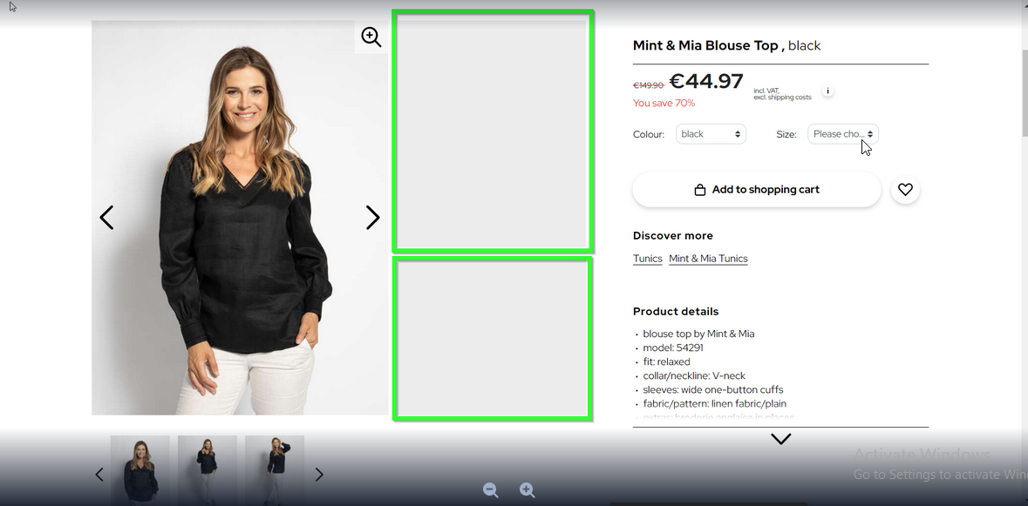

Slide 23
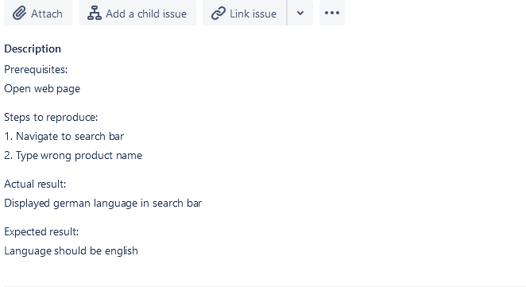
Displayed wrong language in search bar

Slide 24
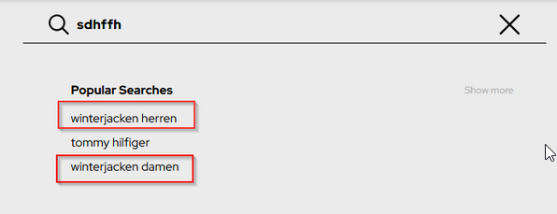

Slide 25

5. Other types of Testing

Slide 26
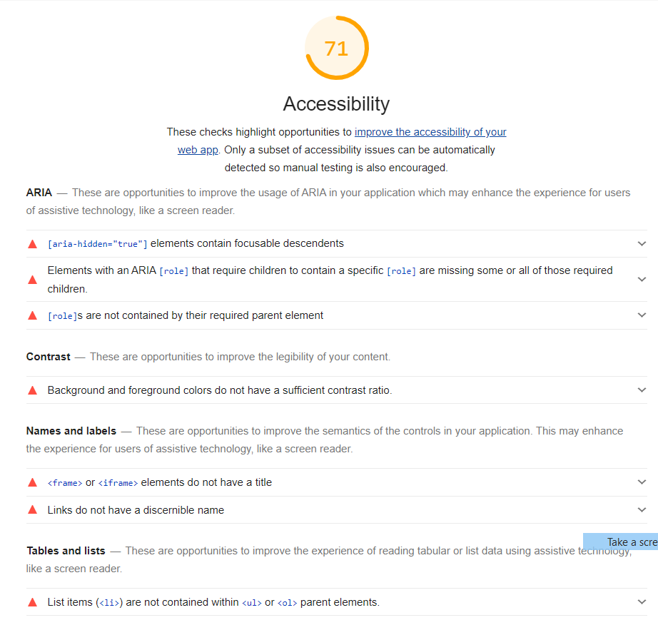
Accessibility Testing

Slide 27
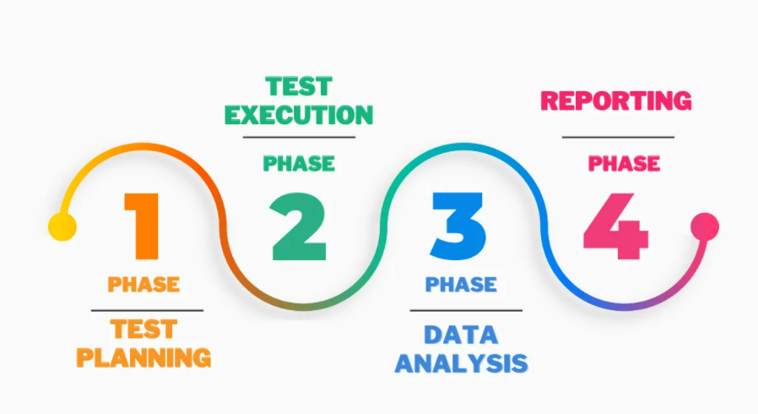
Usability Testing

Slide 28
Questions and Answers of the User in Usability Testing
Is the navigation within the software clear and simple?
Is the design clean and clutter-free?
Is there too much white space?
Does the logo link back to home?
Are there visual clues for links?
Do the look and feel of the application please the user’s eye?
Is the design consistent throughout the application?
Does the tooltip help the user?

Slide 29
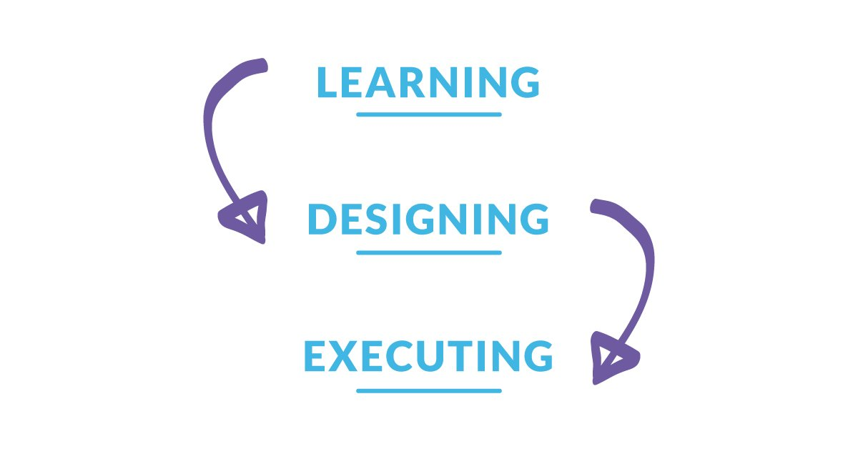
Exploratory Testing

Slide 30

6. Found Issues and
List of Recommendations

Slide 31
Found Issues
Displaying search suggestions in german language.
After searching wrong product inscription comes in german language.
User can’t add more than 3 products to shopping cart.
User can’t choose search bar while using tab.
User can’t see product pictures.
User can’t click 5 images in a row.

Slide 32
Recommendations for improvements
There should be used separated URL links for different languages.
Searchbar should be working impeccably.
Shopping cart should be able to add as many products as user wants.
Website should run without crashing when person clicking different pictures on main page.
Pictures on website should be accurate.

Slide 33

7. SWOT analysis

Slide 34
SWOT analysis www.dress-for-less.com
Strengths:
A lot of discounts
A lot of various brands
Simple interface
Simple registration form
Mobile optimized
Weaknesses:
Slow response speed
A lot of bugs
Long subscription process
Opportunities:
Loading time
New design trends
Quick contact with client
Threats:
Competition
Limited country delivery (Covid19)
Changing customer needs

